Slide 1



An Application To Match Candidates Resumes To An Appropriate Job Description Using AI
Tanuj Joshi – 16010421801
Siddhesh Parkhe – 16010421804
Guide – Prof. Dipti Pawade
Group ID – 41

Slide 2
Problem Definition
In today’s world recruitment has become a tedious process and talent acquisition is essential for all companies irrespective of the size of their business.
If there is an opening for a position In the firm, millions of people will send their resumes to the company to apply for that position.
It is a tough task for a company's recruiters to manually look through hundreds of resumes and choose the best prospects for the position.
Our web application is developed in such a way that it makes the hiring process considerably easier and simpler.
This web application helps us to find the skill score and then rank the candidates resumes, process all the available job descriptions and maintain the key skill set requirement.
Finally it compares the resumes and job descriptions and measures the percent suitability.

Slide 3
Background Work..
Ref No | Year | Dataset | Method
[1] | 2022 | Kaggle | Core Factor And Secondary Factor Calculation, Profile matching algorithm
[2] | 2022 | Data collected from student | Core Factor And Secondary Factor Calculation, Profile matching algorithm
[3] | 2021 | Kaggle | Tokenization, TF-IDF, Stacked model (KNN, Linear SVC, and XGBoost)
[4] | 2021 | Resume collected from user | NER, Cosine Similarity Measure
[5] | 2022 | 200 online resumes | tokenization and token normalization, NER
[6] | 2022 | 2027 resumes | NLP pipeline for data preprocessing, DT, KKN, RBF SVM, CatBoost
Table 1. Work of various authors

Slide 4
Background Work..
Ref No | Year | Dataset | Method
[7] | 2023 | 100 resumes | TF-IDF , BERT vectorization
[8] | 2021 | Resume collected from user | Cosine similarity
[9] | 2019 | Data from PESO | Data mining, similarity calculation, Clustering
[10] | 2023 | Kaggle | TF-IDF Vectorization, Cosine, Sqrt-Cosine, and Improved Sqrt-Cosine (ISC).
[11] | 2022 | Dataset is created through web scraping | Tokenization, Lemmatization, Stop words removal, Cosine similarity, Jaccard Coefficient
[12] | 2023 | 228 resume from LinkedIn, Kaggle, Github | NER, SVM
Table 1. Work of various authors

Slide 5
Background Work..
Ref No | Year | Dataset | Method
[13] | 2023 | Resume collected from user | Tokenization, Stemming, Lemmatization, Cosine Similarity
[14] | 2022 | Dataset from the Budi Luhur University HR | Profile matching based on core factor and secondary factor calculation
[15] | 2021 | 100,000 resume from 123 colleges and universities. | Word segmentation, deactivation, unique word substitution, CNN, BiLSTM, CRNN,BPNN
[16] | 2022 | Dataset of 101 unstructured resumes in the domain of information technology collected from different resources | Skip gram, cocune similarity, NLP gazetteer and pattern matching
[17] | 2021 | 274,407 resume-vacancy pairs(negative and positive) | TF-IDF,BERT, SBERT
Table 1. Work of various authors

Slide 6
Background Work..
Ref No | Year | Dataset | Method
[18] | 2020 | Resume collected from user | Tokenization, Lemmatization, POS Tagging, NER, Vectorization, TF-IDF, Cosine similarity
[19] | 2022 | Dataset containing 14,906 job seeker resumes and 8 JDs collected from various sources | Clustering, Jaccard similarity , linear regression, decision tree, Adaboost, and XGBoost
[20] | 2020 | Kaggle | TF-IDF, Random Forest, Multinomial Naive Bayes, Logistic Regression, Linear Support Vector Machine Classifier, Content Based Recommendation using Cosine Similarity , k-Nearest Neighbours
[21] | 2022 | Information from Kaggle | TF-IDF,Cosine Similarity , k-Nearest Neighbours
[22] | 2022 | Set of resumes | Stacked models
Table 1. Work of various authors
Table 1. Work of various authors

Slide 7
Background Work
Ref No | Year | Dataset | Method
[23] | 2021 | Resume repository | Stacked KNN Learner Module
[24] | 2021 | Resume from user | KNN
Table 1. Work of various authors

Slide 8
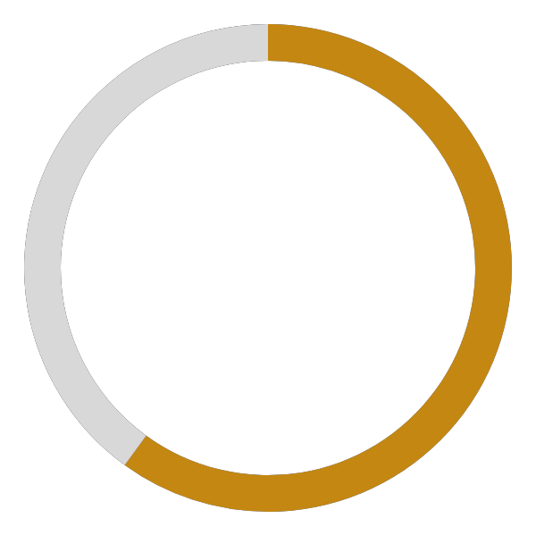
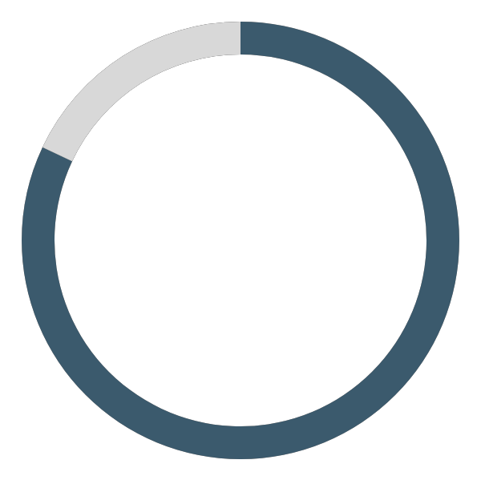


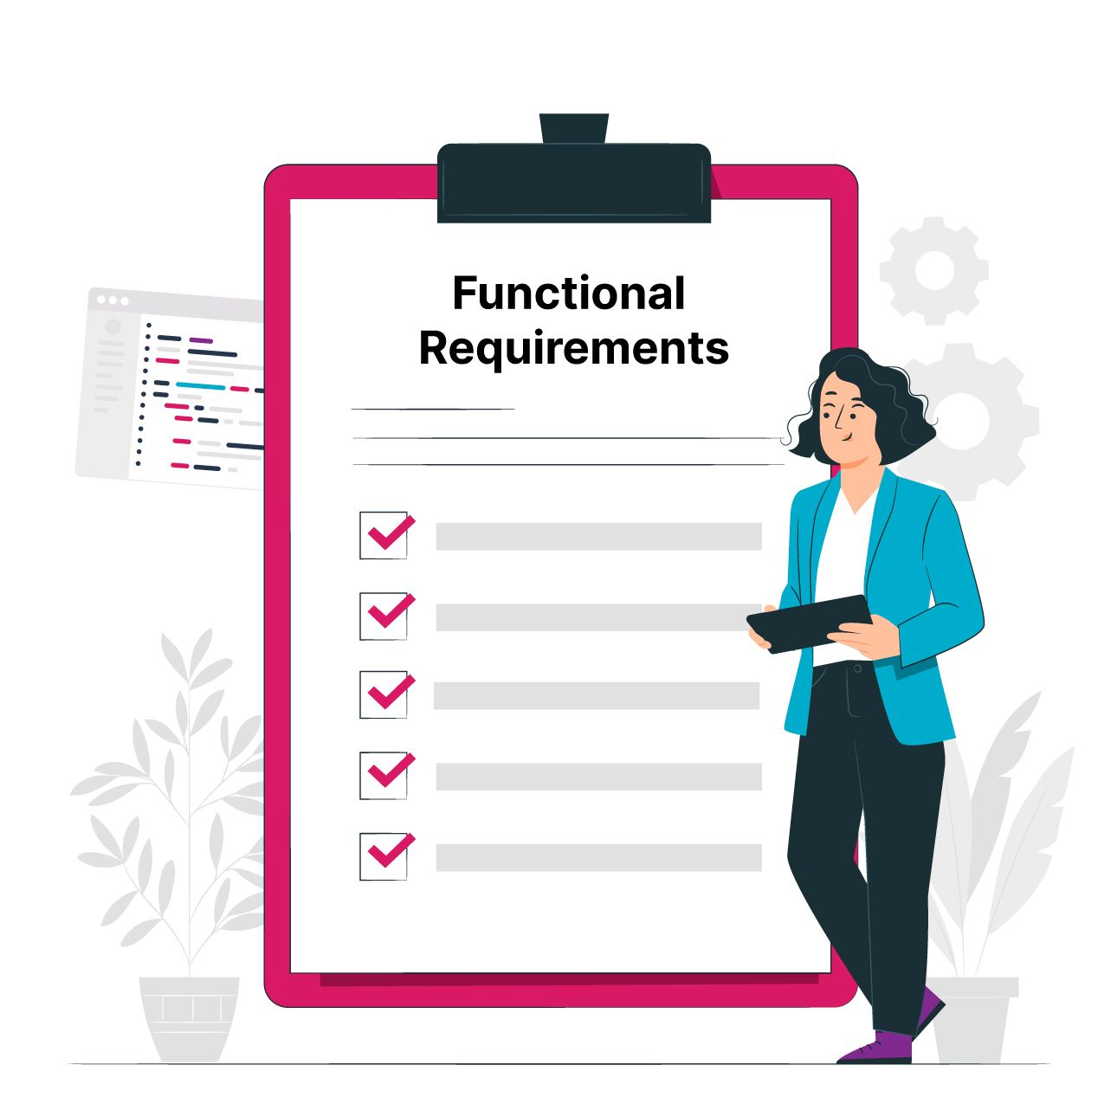
Functional Requirements
Extracting key skill set requirement from job description
Resume and job description comparison
Resume preprocessing
Finding Skill Score of resume
Measure percentage suitability

Slide 9
Non-Functional Requirements
Reliability
Portability
Flexibility
Security
Usability
Availability

Slide 10


Dataset
We collected 230 resumes from various websites through scrapping.
JD collected were of 12 different categories.
Online Skills dataset consisting of 1000’s of skills of multiple domains.

Slide 11
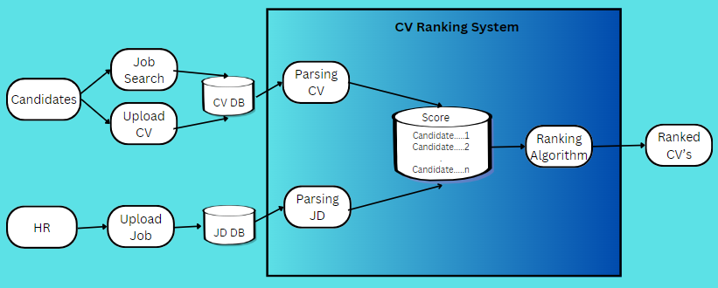
System Design
Fig 1. Working of Web Application

Slide 12

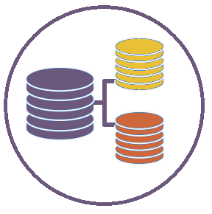
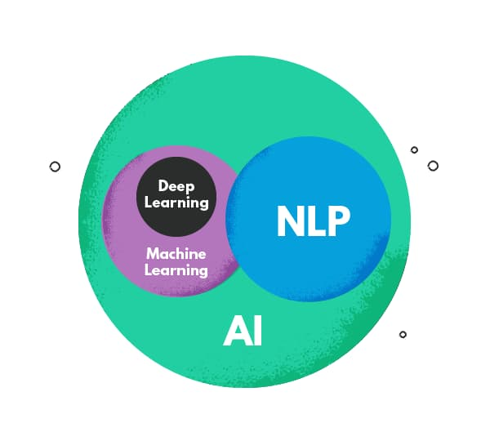
Work Done Till Now
Comprehensive Literature Survey
Wrote a research paper which is selected for conference
Customized Dataset
Tested using NLP based approach – KNN
Tested using ML based approach – BERT, Doc2Vec

Slide 13
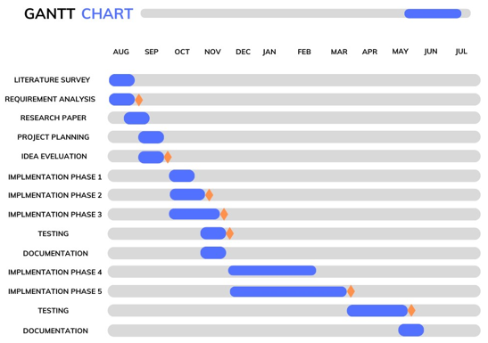
Gantt Chart
Fig 2. Timeline for the project

Slide 14


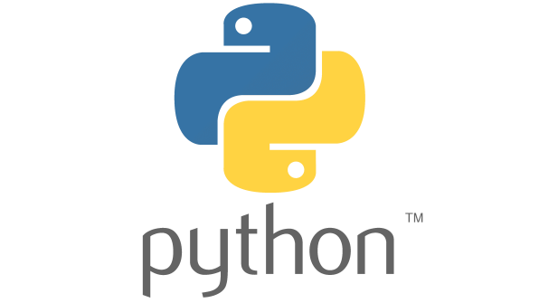

Technologies Used

Slide 15
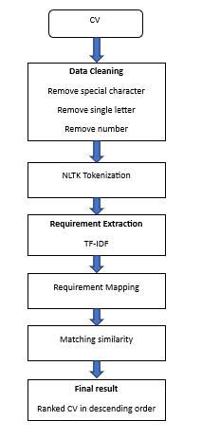
Implementation
Fig 3. Flow Diagram of system

Slide 16
Conclusion
In this study, an web based AI CV Ranker application has been developed to find the percentage suitability between the posted JD and uploaded CV. The application not only does the matching but also displays the rank of each resumes according their score using BERT and KNN model. The models have been trained using our own dataset and has attained an accuracy of around 93.85% and 79.00% respectively. This project has helped us develop a new perspective for commonly used machine learning algorithms and to extract more than just predictions. The natural language processing toolkit (NLTK) and KNN algorithms, have been helpful in carrying out the results. Also, working with huge unstructured data, with a variety of forms was a challenge, especially to extract correct information from it. Moreover, Pandas, Numpy, Matplotlib and Sklearn were other Python libraries that were used.

Slide 17
Results
In the resume ranking application we tried using 2 models and the results which we have achieved are given below in Table 7.
ID | Model | Accuracy | Metric
 |  |  | Precision | Recall | F1-Score
1. | KNN | 79. 00 | 90.00 | 79.00 | 82.00
2. | BERT | 93.85 | 94.00 | 94.00 | 94.00
Table 2. Analysis using two models

Slide 18

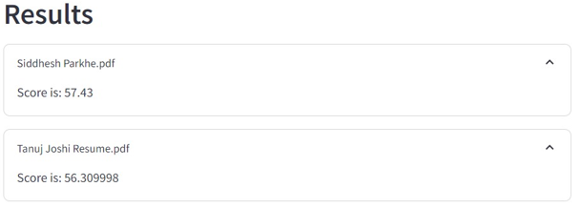
Results
The following images displays the suitability percentage between JD and CV achieved by KNN and BERT.
Fig 4. KNN Results
Fig 5. BERT Results

Slide 19
References..
[1] Cucus, Ahmad, Luhur Bayu Aji, Al-Fahim Bin Mubarak Ali, Afrig Aminuddin, and Lilis Dwi Farida. "Selection of Prospective Workers Using Profile Matching Algorithm on Crowdsourcing Platform." In 2022 5th International Conference on Information and Communications Technology (ICOIACT), pp. 122-126. IEEE, 2022.
[2] Wahyono, Irawan Dwi, Khoirudin Asfani, Hari Putranto, Djoko Saryono, Herri Akhmad Bukhori, Tiksno Widyatmoko, Mohd Shafie Rosli, Nurbiha A. Shukor, and Noor Dayana Abdul Halim. "Selection Modification of Model in Profile Matching Algorithm for Admission and Placement of Assistant Members." In 2022 IEEE 8th Information Technology International Seminar (ITIS), pp. 1-6. IEEE, 2022.
[3] Ransing, Rasika, Akshaya Mohan, Nikita Bhrugumaharshi Emberi, and Kailas Mahavarkar. "Screening and Ranking Resumes using Stacked Model." In 2021 5th International Conference on Electrical, Electronics, Communication, Computer Technologies and Optimization Techniques (ICEECCOT), pp. 643-648. IEEE, 2021.
[4] M. Alamelu, D. S. Kumar, R. Sanjana, J. S. Sree, A. S. Devi and D. Kavitha, "Resume Validation and Filtration using Natural Language Processing," 2021 10th International Conference on Internet of Everything, Microwave Engineering, Communication and Networks (IEMECON), Jaipur, India, 2021, pp. 1-5, doi: 10.1109/IEMECON53809.2021.9689075.
[5] Narendra, G. O., and S. Hashwanth. "Named Entity Recognition based Resume Parser and Summarizer."
[6] Boonchob, Thapanee, Nuengwong Tuaycharoen, Santisook Limpeeticharoenchot, and Narongthat Thanyawet. "Job-Candidate Classifying and Ranking System-Based Machine Learning Method." In 2022 26th International Computer Science and Engineering Conference (ICSEC), pp. 94-99. IEEE, 2022.
[7] Tallapragada, VV Satyanarayana, V. Sushma Raj, U. Deepak, P. Divya Sai, and T. Mallikarjuna. "Improved Resume Parsing based on Contextual Meaning Extraction using BERT." In 2023 7th International Conference on Intelligent Computing and Control Systems (ICICCS), pp. 1702-1708. IEEE, 2023.
[8] Khamker, Niti, Y. Khamker, and M. Butwall. "Resume match system." International Journal Of Innovative Science And Research Technology (2021).

Slide 20
References..
[9] Rodriguez, Leah G., and Enrico P. Chavez. "Feature selection for job matching application using profile matching model." In 2019 IEEE 4th International Conference on Computer and Communication Systems (ICCCS), pp. 263-266. IEEE, 2019.
[10] A. Alsharef, Sonia, H. Nassour and J. Sharma, "Exploring the Efficiency of Text-Similarity Measures in Automated Resume Screening for Recruitment," 2023 10th International Conference on Computing for Sustainable Global Development (INDIACom), New Delhi, India, 2023, pp. 36-42.
[11] Alsaif, Suleiman Ali, Minyar Sassi Hidri, Hassan Ahmed Eleraky, Imen Ferjani, and Rimah Amami. "Learning-based matched representation system for job recommendation." Computers 11, no. 11 (2022): 161.
[12] Alderham, Asrar Hussain, and Emad Sami Jaha. "Comparative Semantic Resume Analysis for Improving Candidate-Career Matching." In 2022 14th International Conference on Computational Intelligence and Communication Networks (CICN), pp. 313-321. IEEE, 2022.
[13] B. Lalitha, S. Kadiyam, R. V. Kalidindi, S. M. Vemparala, K. Yarlagadda and S. V. Chekuri, "Applicant Screening System Using NLP," 2023 International Conference on Innovative Data Communication Technologies and Application (ICIDCA), Uttarakhand, India, 2023, pp. 379-383, doi: 10.1109/ICIDCA56705.2023.10099953.
[14] Painem, H. Soetanto and U. Budiyanto, "Analysis of Job Placement Based on Employee Competency Using Profile Matching," 2022 9th International Conference on Electrical Engineering, Computer Science and Informatics (EECSI), Jakarta, Indonesia, 2022, pp. 394-398, doi: 10.23919/EECSI56542.2022.9946448
[15] Liu, Jiahao, Yifan Shen, Yijie Zhang, and Sujatha Krishnamoorthy. "Resume parsing based on multi-label classification using neural network models." In Proceedings of the 6th International Conference on Big Data and Computing, pp. 177-185. 2021.

Slide 21
References..
[16] Amro, Belal, Arwa Najjar, and Mario Macido. "An Intelligent Decision Support System For Recruitment: Resumes Screening and Applicants Ranking." (2022).
[17] Lavi, Dor, Volodymyr Medentsiy, and David Graus. "consultantbert: Fine-tuned siamese sentence-bert for matching jobs and job seekers." arXiv preprint arXiv:2109.06501 (2021).
[18] Daryani, Chirag, Gurneet Singh Chhabra, Harsh Patel, Indrajeet Kaur Chhabra, and Ruchi Patel. "An automated resume screening system using natural language processing and similarity." ETHICS AND INFORMATION TECHNOLOGY [Internet]. VOLKSON PRESS (2020): 99-103.
[19] Sridevi, G. M., and S. Kamala Suganthi. "AI based suitability measurement and prediction between job description and job seeker profiles." International Journal of Information Management Data Insights 2, no. 2 (2022): 100109.
[20] Roy, Pradeep Kumar, Sarabjeet Singh Chowdhary, and Rocky Bhatia. "A Machine Learning approach for automation of Resume Recommendation system." Procedia Computer Science 167 (2020): 2318-2327.
[21] Tejaswini, K., Umadevi, V., Kadiwal, S.M. and Revanna, S., 2022. Design and development of machine learning based resume ranking system. Global Transitions Proceedings, 3(2), pp.371-375.
[22] Xu P., Barbosa D. (2018) Matching Résumés to Job Descriptions with Stacked Models. In: Bagheri E., Cheung J. (eds) Advances in Artificial Intelligence. Canadian AI 2018. Lecture Notes in Computer Science, vol 10832. Springer, Cham. https://doi.org/10.1007/978-3-319-89656-4_31
[23] Mishra, Sushruta & Mallick, Pradeep Kumar & Tripathy, Hrudaya & Jena, Lambodar & Chae, Gyoo-Soo. (2021). Stacked KNN with hard voting predictive approach to assist hiring process in IT organizations. The International Journal of Electrical Engineering & Education. 002072092198901. 10.1177/0020720921989015.
[24] Rajath V , Riza Tanaz Fareed , Sharadadevi Kaganurmath, 2021, Resume Classification and Ranking using KNN and Cosine Similarity, international journal of engineering research & technology (IJERT) Volume 10, Issue 08 (August 2021)

Slide 22
Thank You

